Slide 1
TCS Cyber Security Practice
Access Management Foundations
10 June 2019
Version 1.0

Slide 2

Agenda
Access Management
Directory Services

Slide 3
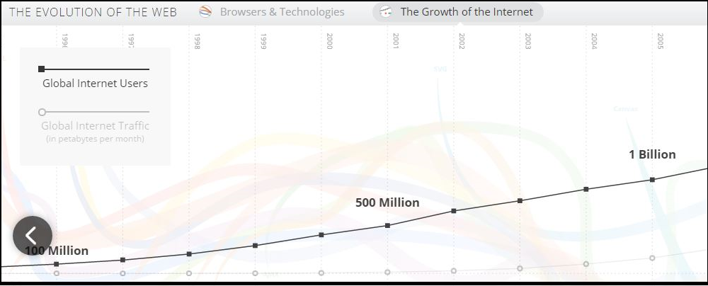
The Evolution of Web
Breadth and Depth of IAM Experience and skills across Products, Verticals, and Geographies

Slide 4
Where it started ?
Organization pain points due to evolution of websites
1
How to share user identity across multiple websites without forcing the user to log in more than once.
(Improve User Experience)
2
Reduce access management security development and administrator cost
(Reduce Helpdesk cost)
3
Enhances security and flexible access to web applications on premises or a partner’s site.
(Improve Security & Productivity )

Slide 5
How Access Management is Beneficial?
1
Security Code is removed from applications and put into WAM rules and policies
2
Access Management shifts responsibility for security from application developer to Access Management Administrator
3
Enhances security and flexible access management to web applications on premises or a partner’s site

Slide 6
Key Features of Access Management
1
Secure single sign-on provides seamless access across multiple cloud, mobile and web applications from any device.
2
Identity federation facilitates access to cloud, internal or partner apps via open standards, including OpenID Connect, OAuth, SAML, WS-Federation and eGov.
3
Social login supports dozens of identity providers, allowing your customers to leverage their social identities to log in.
4
Centralized Policy-based authorization allows you to grant or deny access to resources based on roles, attributes or context.
5
Centralized Authentication session management enables you to securely manage and protect a user’s session.
6
Flexible architecture models support a variety of architecture and integration options to adapt to any environment and use case.

Slide 7
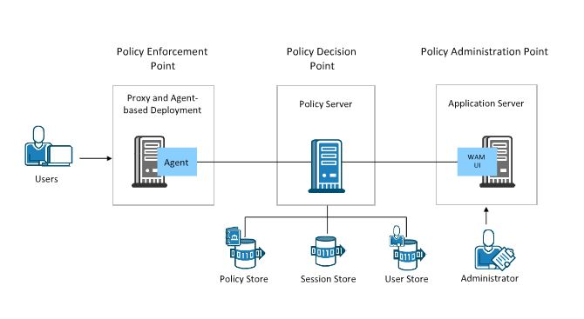
Access Management Components

Slide 8
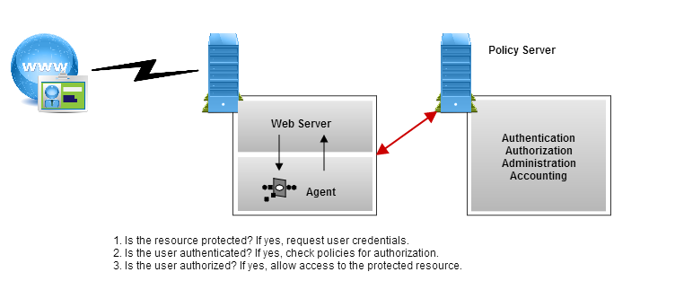
Access Management Integrations – Agent Based
1
3
4
Web Agents
Web Agents operate with web servers, to handles Authentication & Authorization process.
Application Server Agents
can protect the Web Applications & EJB components
Web Services Security (WSS) Agents can authenticate and authorize requests for access to SOAP/XML-based web services
2
A RADIUS Agent secures an entire application that communicates using the RADIUS protocol.

Slide 9
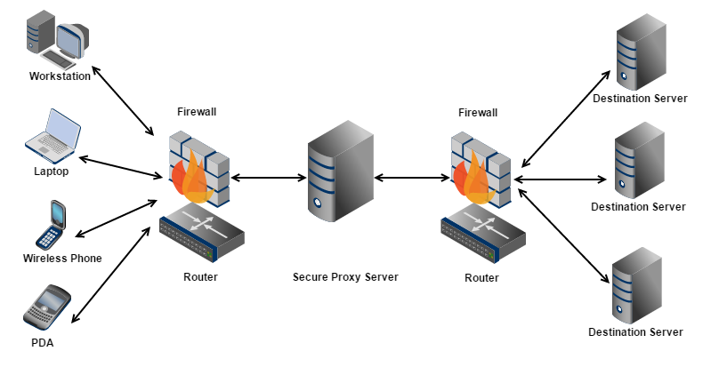
Access Management Integration – Gateway Based
*SAML Based Integration
It is used to implement SSO across organizations

Slide 10
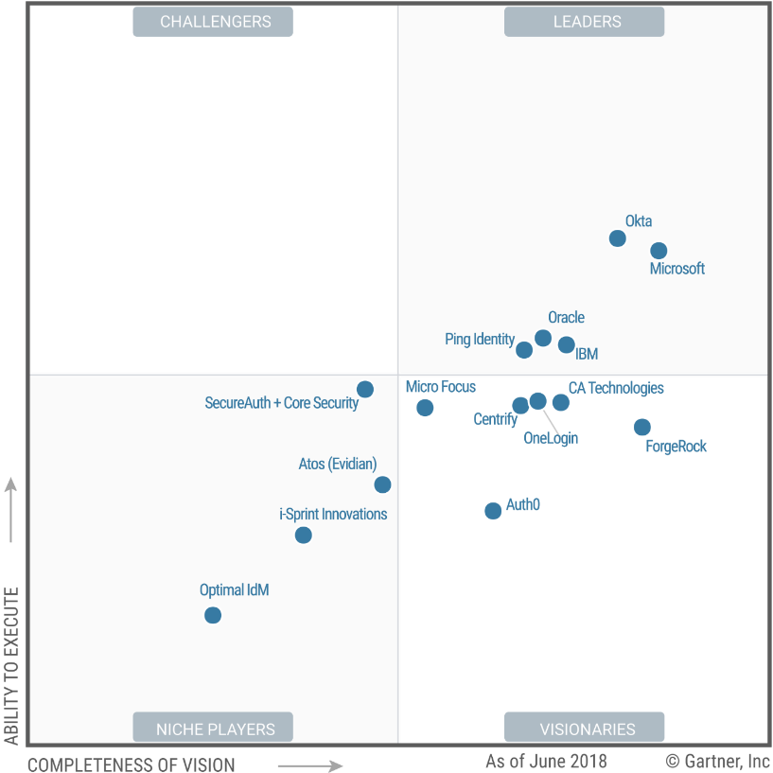
Magic Quadrant for Access Management

Slide 11





Directory Services Overview
3

Slide 12
Directory Services - Definition
A data registry used to store network, user, computer, server related data in any enterprise
architecture
Stores the data in a Directory Information Tree (DIT) which contains descriptive, attribute-based
and hierarchical storage
Forms a foundation for enterprise eBusiness applications
Supports sophisticated filtering and searching capabilities
Optimized to give quick responses to high volume lookup / search operations
Accessible using any of the below communication protocol:
– Lightweight Directory Access Protocol – LDAP
– Directory Services Markup Language – DSML

Slide 13
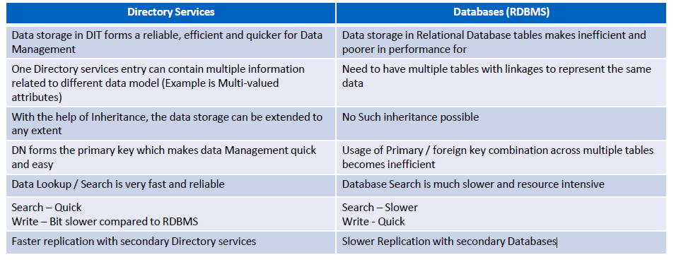
Directory Services Vs. Database

Slide 14
LDAP – Introduction and Concepts
LDAP is a common language / protocol used by servers and clients to communicate with Directory Services
LDAP stands for Lightweight Directory Access Protocol which in turn inherits the standards of X-500 defined by ISO / ITU and runs over TCP/IP
The current running LDAP version is v3 and all the directory services in industry supports LDAP v3
LDAP v3 Search supports the Equality, Inequality, Substring, Approximate match (for phonetic matching), greater than, less than, Boolean combinations of the previous filters using the and (&), or (|), and not (!) operators
For exchange of directory information between the servers, LDAP uses LDAP Data Interchange Format (LDIF)

Slide 15
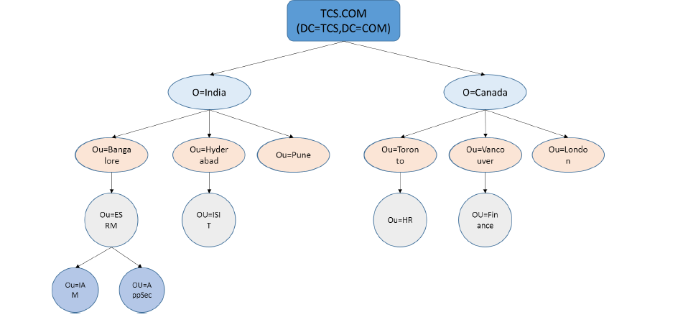
Typical LDAP Directory Information Tree (DIT) Structure

Slide 16
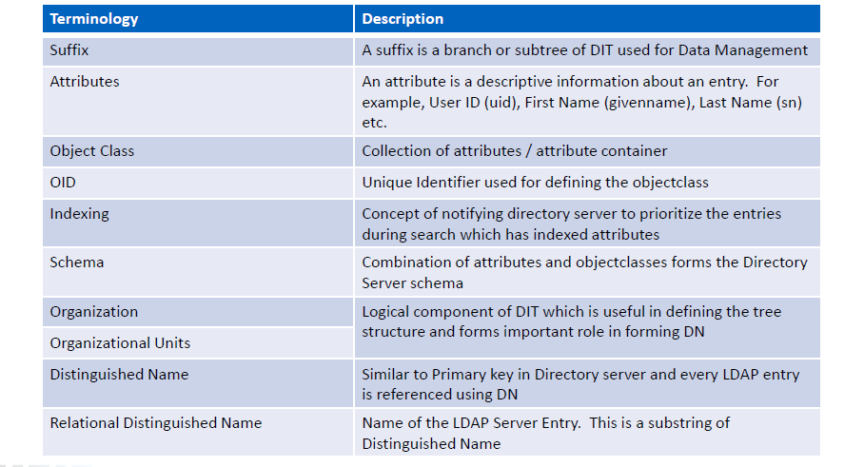
LDAP Terminologies

Slide 17
Directory Services – Server Replication
In a typical production environment, the business critical applications configured with
Directory servers as backend needs High Availability during the fail-overs. To cover these
fail-overs, Directory servers are often configured for replication so that the directory data
coming from application is not lost
Typically, there are two kinds of replication setup possible:
– Master – Master Replication: Here, both the directory servers acts as master and
receives the data together from application. This setup is more suitable when multi node
application is load-balanced and the traffic can route to any instance of application
– Master – Slave Replication: Here, master directory server receives the data from
application and syncs up the slave directory server. This synchronization may be in a real
time or may be a scheduled process. During the fail-over situations, the slave directory
server needs to be manually configured as master.

Slide 18
Directory Services - Vendors
Active Directory
Apache Directory Server
NetIQ Directory Server
Red Hat Directory Server
Oracle Internet Directory Server
IBM Security Directory Server
Ping Directory
OpenLDAP

Slide 19
Thank You

